Slide 1


Salary Prediction: Final Report
CS479 Data Science - Spring 2024
Dawson Burgess
Alphonse Crittenden
Bryan Frahm
Lucien Lee
Nyah Nelson
Notes:
Dawson

Slide 2
1.
Investigation
Notes:
Nyah

Slide 3
Investigation and Data Science Goal
Investigation - understanding factors affecting job salary
Goal - develop models to predict data science job salaries based on job description details
Driven by a curiosity of data science career outlook
Dataset - jobs dataset with job information from Glassdoor in 2017-2018
Mode of collection was through observation
Dataset was found on Kaggle
Dataset is organized as a csv file
Metadata is exported as a json file using croissant metadata format
Notes:
Nyah

Slide 4
Dataset
Found:
The dataset is available open-source on Kaggle
Easily exported
The data was collected from job postings on Glassdoor in 2017-2018
Thorough data and metadata documentation available on Kaggle
Managed:
The data is organized in a csv file with 742 different jobs and 33 features
Easy to manage and export (not too big)
Pre-processing needed:
Removing unnecessary features for salary prediction
Encoding categorical features to numerical values
The source on Kaggle already had a ‘cleaned’ dataset with encoded attributes
Exploratory data analysis needed:
Find significant relationships of variables
Correlations
Key features needed to prepare model
Notes:
Nyah

Slide 5
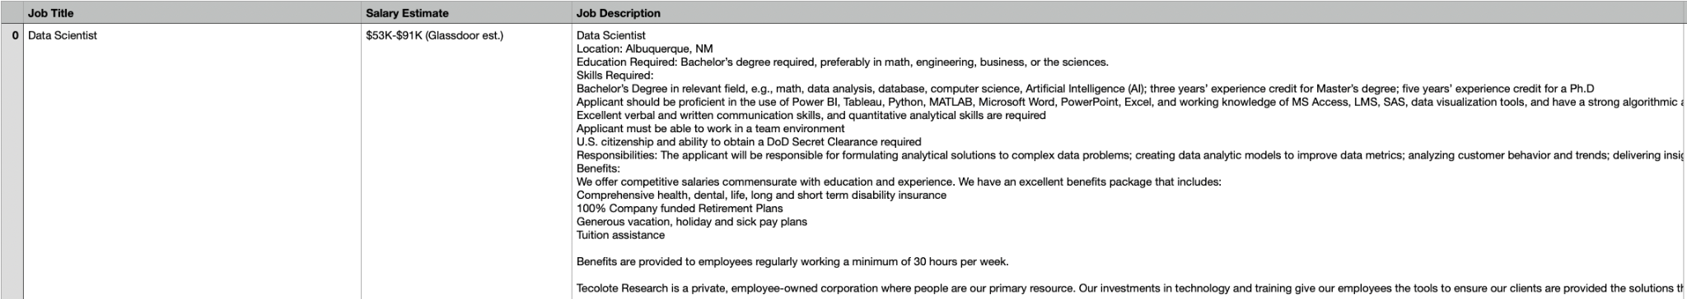
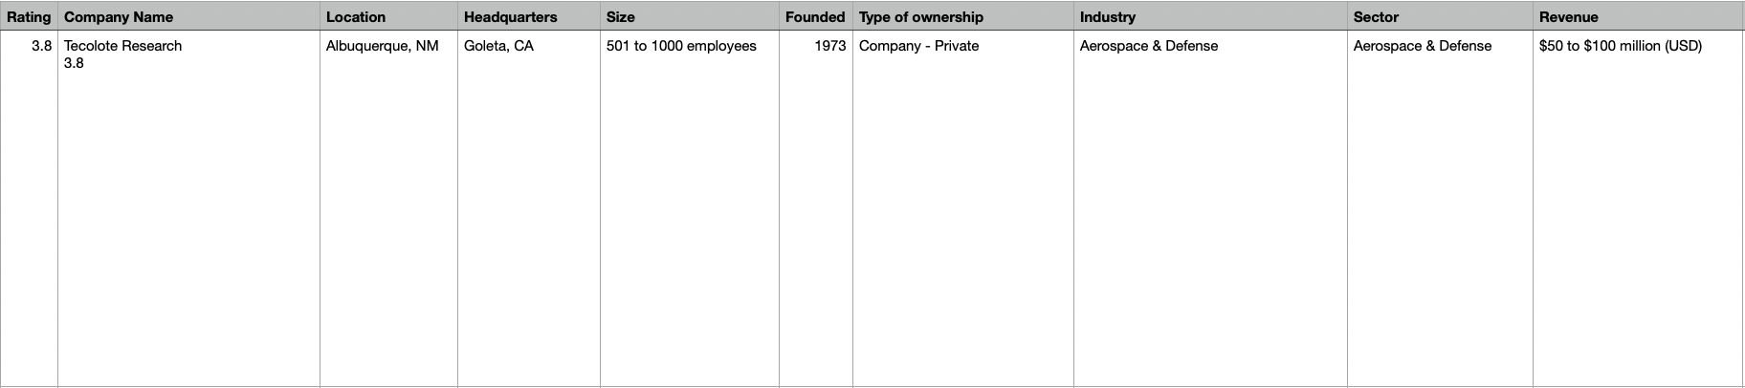
Dataset
Notes:
Nyah

Slide 6
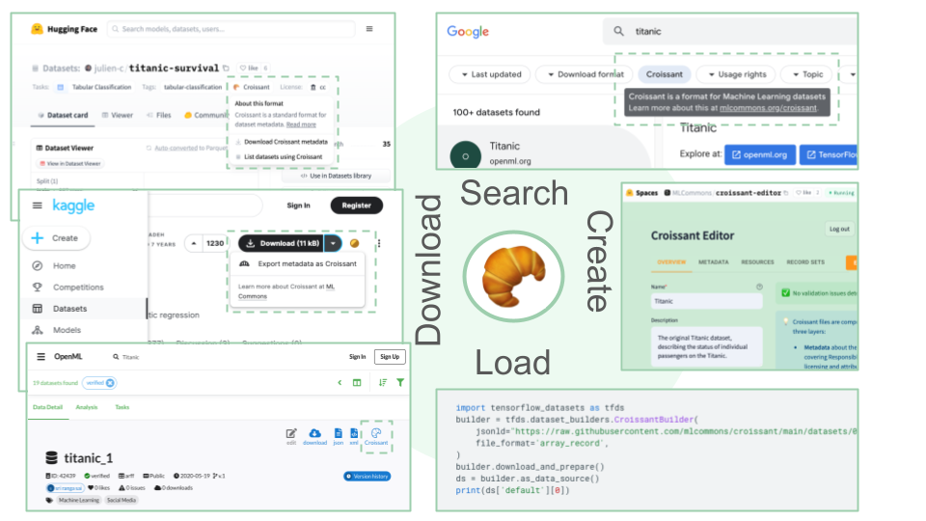
MetaData
Metadata exported as a json file using Croissant metadata format for ML datasets
All kaggle datasets use Croissant format
Format has easy integration with ML frameworks
Makes it easier to search for datasets and train datasets
Features
Dataset context and description
License
Column names and descriptions
Creator
publisher
Notes:
Nyah

Slide 7
Exploratory Data Analysis
Compared the relationship between the average salary and every other attribute
Categorical attributes
Used ANOVA - analysis of variance
One-way ANOVA for one independent categorical variable and one dependent continuous variable (average salary)
Analyzed the p-value
P-value (probability value) - value that determines the significance of an observed result
A low p-value means a more significant relationship
Attribute title | p-value
Size | 3.65 x 10⁻⁶
Types of ownership | 1.6 x 10⁻¹⁴
industry | 2.64x 10⁻¹⁶
Sector | 1.84 x 10⁻¹⁴
seniority | <2 x 10⁻¹⁶
Location | <2 x 10⁻¹⁶
Revenue | 2.51 x 10⁻⁹
Notes:
Nyah

Slide 8
Exploratory Data Analysis
Compared the relationship between the average salary and every other attribute
Numerical Attributes
Used cor() function in R
Calculates the correlation coefficient of two numeric variables
Analyzed the correlation coefficient
Correlation coefficient - a measure of the strength and direction of the linear relationship between two variables
A value closer to -1 or 1 means a strong, linear relationship
Attribute Title | Correlation coefficient
Python | 0.32
AWS | 0.17
Spark | 0.18
Hourly | -0.36
Notes:
Nyah

Slide 9
2.
Data Analysis
Notes:
Alphonse

Slide 10
Question 1
Is there a correlation between the company rating and average salary?
Preliminary Analysis: Utilize the provided dataset on company ratings and salaries to visually explore the relationship between company ratings and average salaries through scatter plots and correlation coefficients. Analyze any initial patterns or trends observed in the data.
Full Analysis: Apply linear regression analysis to quantify the correlation between company ratings and average salaries. Train a regression model using company ratings as independent variables and average salaries as the dependent variable. Evaluate the model's performance using the metrics mean squared error and R-squared score.
Post Analysis: Interpret the regression results to determine the strength and significance of the correlation between company ratings and average salaries. Discuss potential implications of the findings, considering factors such as the influence of company reputation on salary negotiations and employee satisfaction.
Notes:
Alphonse

Slide 11
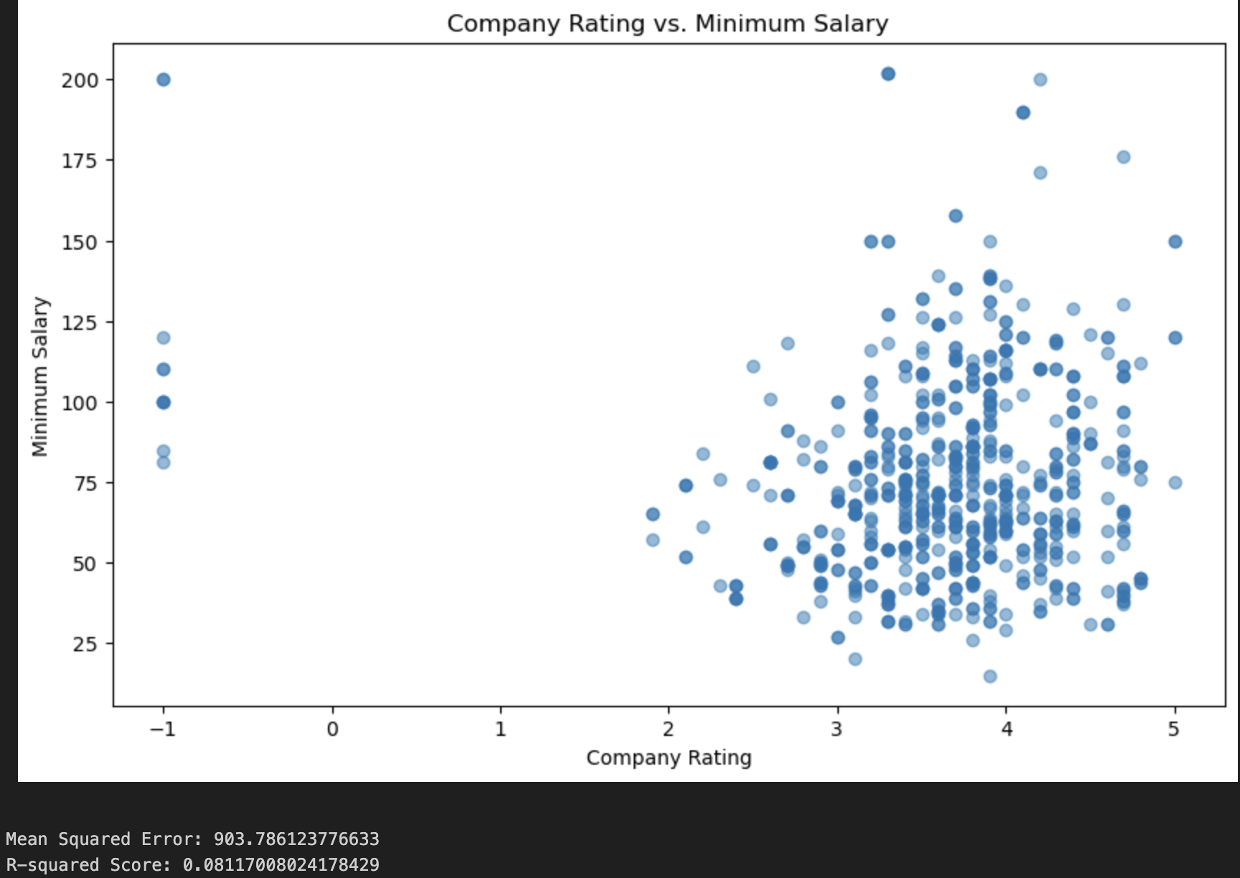
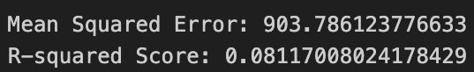
Answer 1
Weak relationship observed between company rating and minimum salary.
Predicted salaries deviate from actual salaries by an average of approximately $903.79.
Company rating explains only about 8.1% of the variance in minimum salaries.
Other factors likely play a more significant role in determining salary levels.
Notes:
Alphonse

Slide 12
Question 2
Is there a correlation between certain job descriptions, titles, or words that result in an increased salary?
Preliminary Analysis: Utilize natural language processing techniques to preprocess and analyze job descriptions from the provided dataset. Identify relevant keywords or phrases associated with high-salary positions through frequency analysis or sentiment analysis. Visualize the distribution of salaries based on job titles or keywords.
Full Analysis: Employ regression analysis to quantify the correlation between specific job descriptions, titles, or keywords and salary levels. Train a regression model using job descriptions or title features as independent variables and salary as the dependent variable. Assess the model's performance and significance of features through metrics such as coefficients and p-values.
Post Analysis: Interpret the regression results to identify significant predictors of increased salary, such as specific skills, responsibilities, or industry sectors mentioned in job descriptions. Discuss potential implications for job seekers in tailoring their resumes and focusing on high-value skills or experiences. Additionally, consider the relevance of these findings for employers in attracting and retaining talent.
Notes:
Alphonse

Slide 13
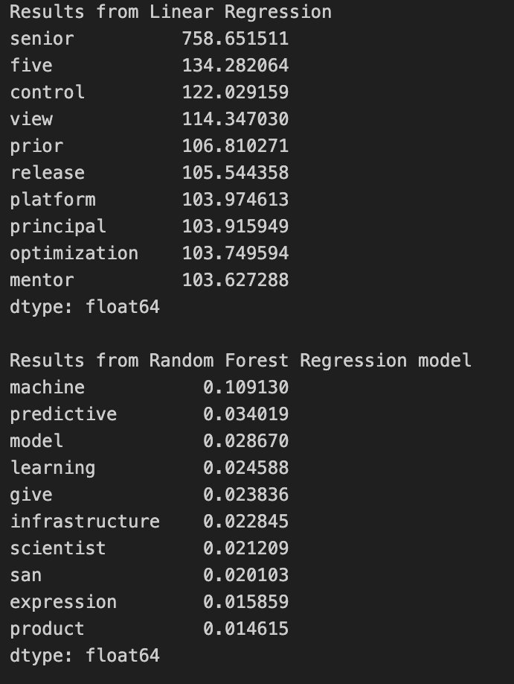
Answer 2
These are the results from semantical analysis:
The first results are from using linear regression
Shows the top 10 words that are associated with a higher paying job.
The higher the number, the larger the correlation.
The second block of output is the results of using a Random Forest Regression
Sows the top 10 words associated with a higher paying job
The higher the number, the more it's associated with a higher paying job.
Notes:
Alphonse

Slide 14
ML models
Initially, we employed linear regression to investigate correlations between company ratings and average salaries, as well as to analyze the impact of certain job descriptions or titles on salary levels.
Subsequently, we extended our analysis to include other machine learning techniques such as
random forest regression
gradient boosting
support vector machines
decision trees
k-nearest neighbors
ridge regression
lasso regression.
Notes:
Lucien

Slide 15
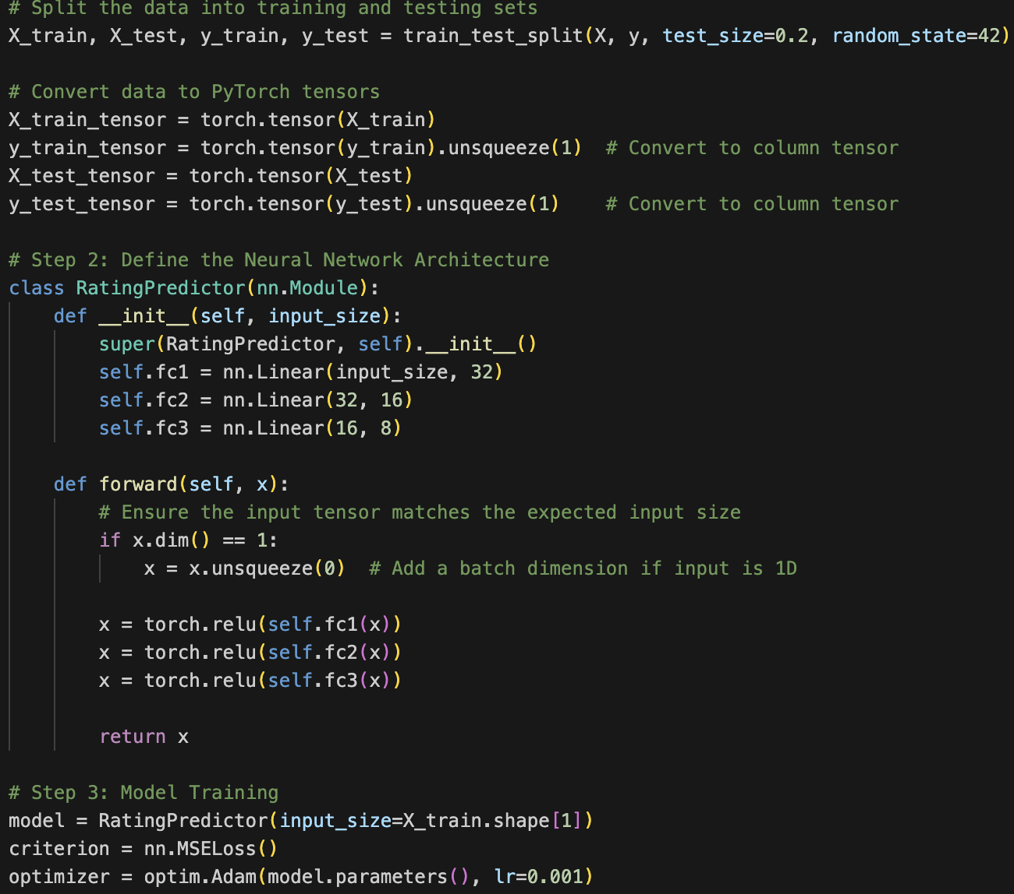
ML models
To further extend analysis, our team utilized PyTorch to craft a custom neural network model to train on, test, and analyze the data.
Here is a quick look at our neural network model:
It has 3 hidden layers
Uses Adam optimizer
ReLU, short for rectified linear unit, is a non-linear activation function
Notes:
Lucien

Slide 16
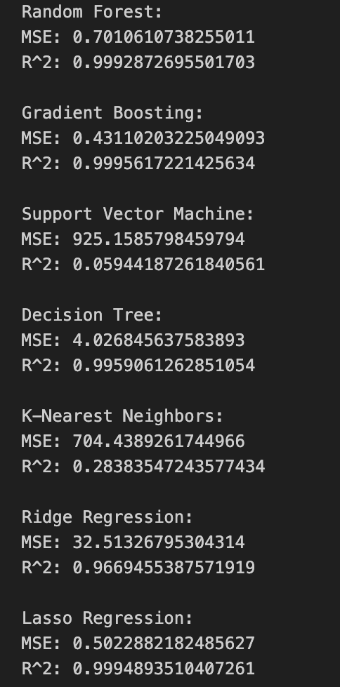
Validate models (results)
Random Forest and Gradient Boosting achieved very low Mean Squared Error (MSE) and high R-squared (R^2) scores, suggesting excellent predictive performance.
Support Vector Machine (SVM) had a high MSE and relatively low R^2, indicating poorer performance compared to other models.
Decision Tree had a relatively high MSE but a high R^2, suggesting overfitting.
K-Nearest Neighbors (KNN) showed a moderate MSE and R^2, indicating average predictive performance.
Ridge and Lasso Regression had low MSE and high R^2, indicating good predictive performance.
Notes:
Lucien

Slide 17
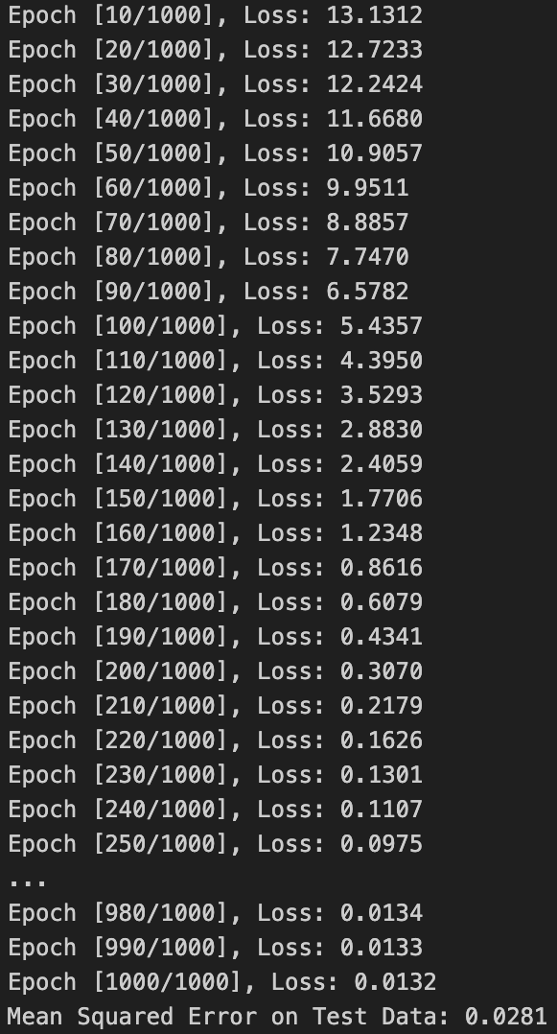
Validate models (results)
The loss decreases steadily over epochs, indicating that the model is learning and improving its predictions.
The mean squared error (MSE) on the test data is very low (0.0281), suggesting that the model performs well in predicting salaries based on the features.
Overall, the decreasing loss and low MSE on the test data indicate that the neural network is effectively capturing the relationships between the input features and the target variable.
Notes:
Lucien

Slide 18
3.
Visualization
Notes:
Dawson

Slide 19
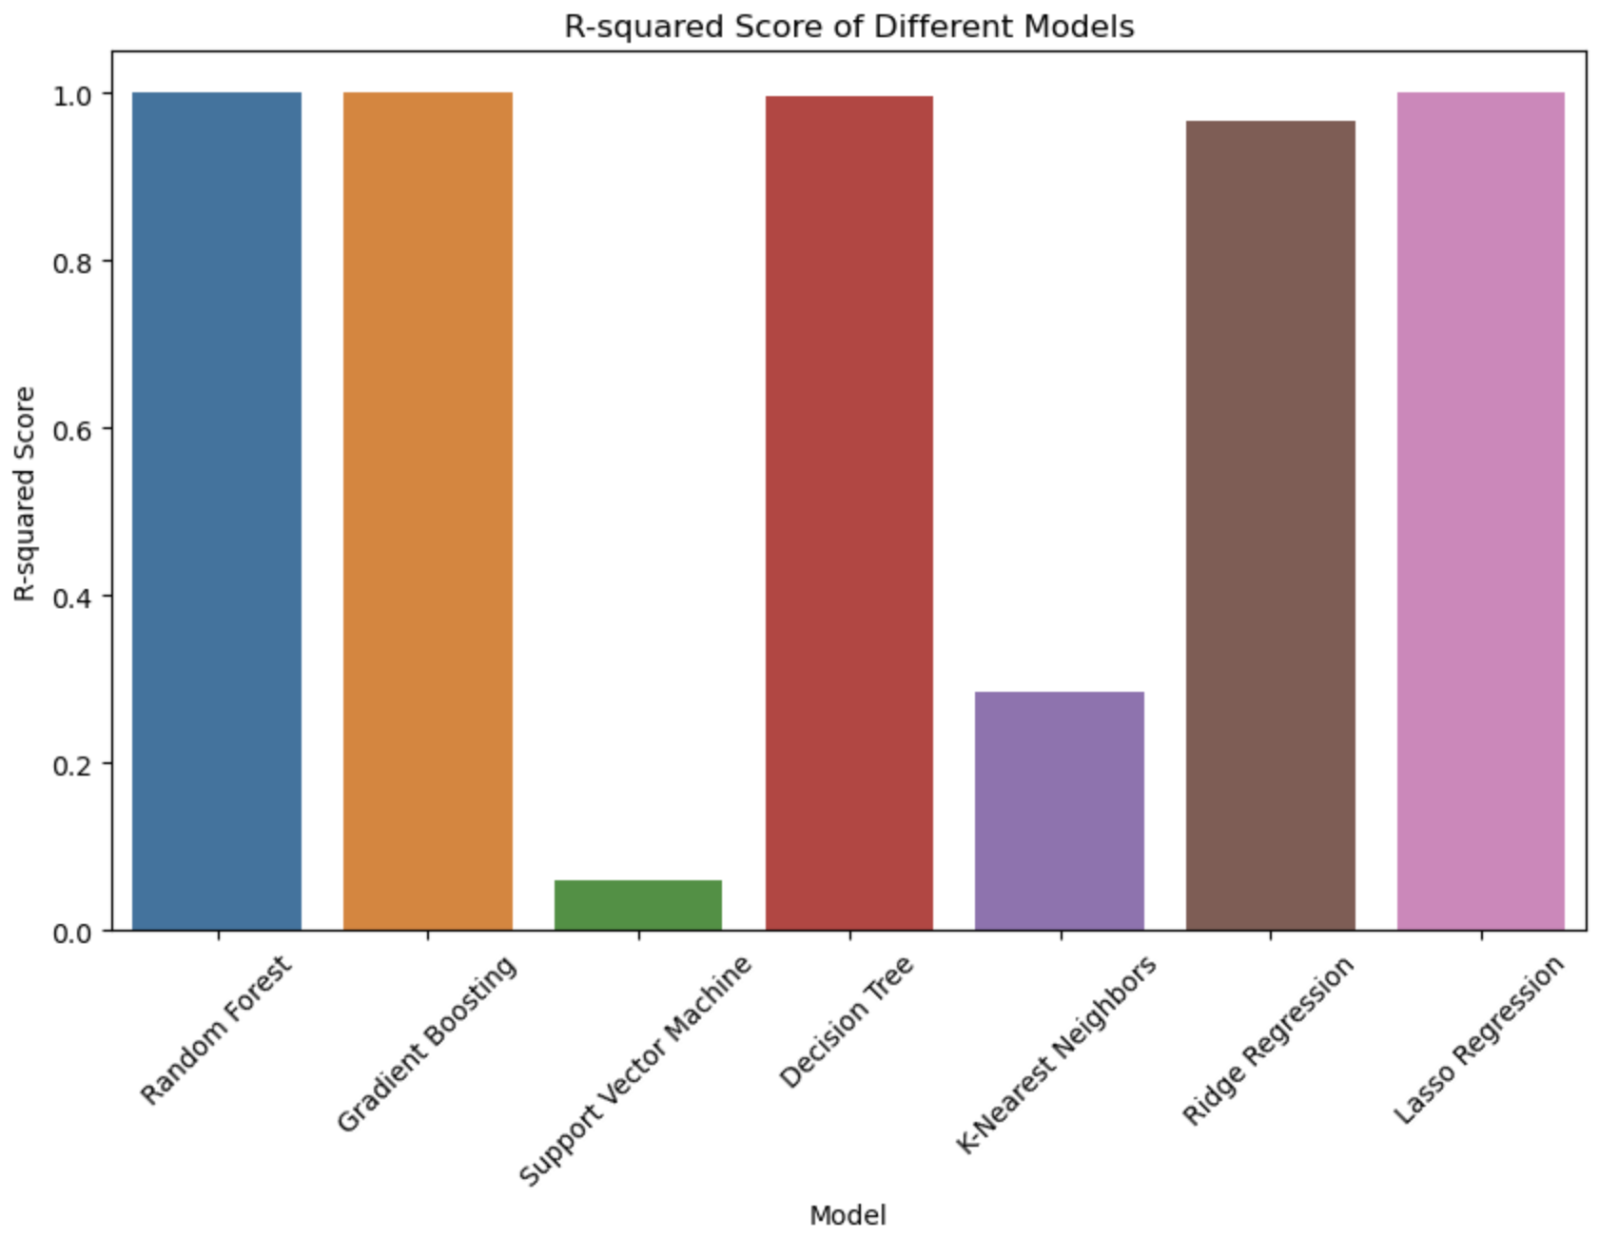
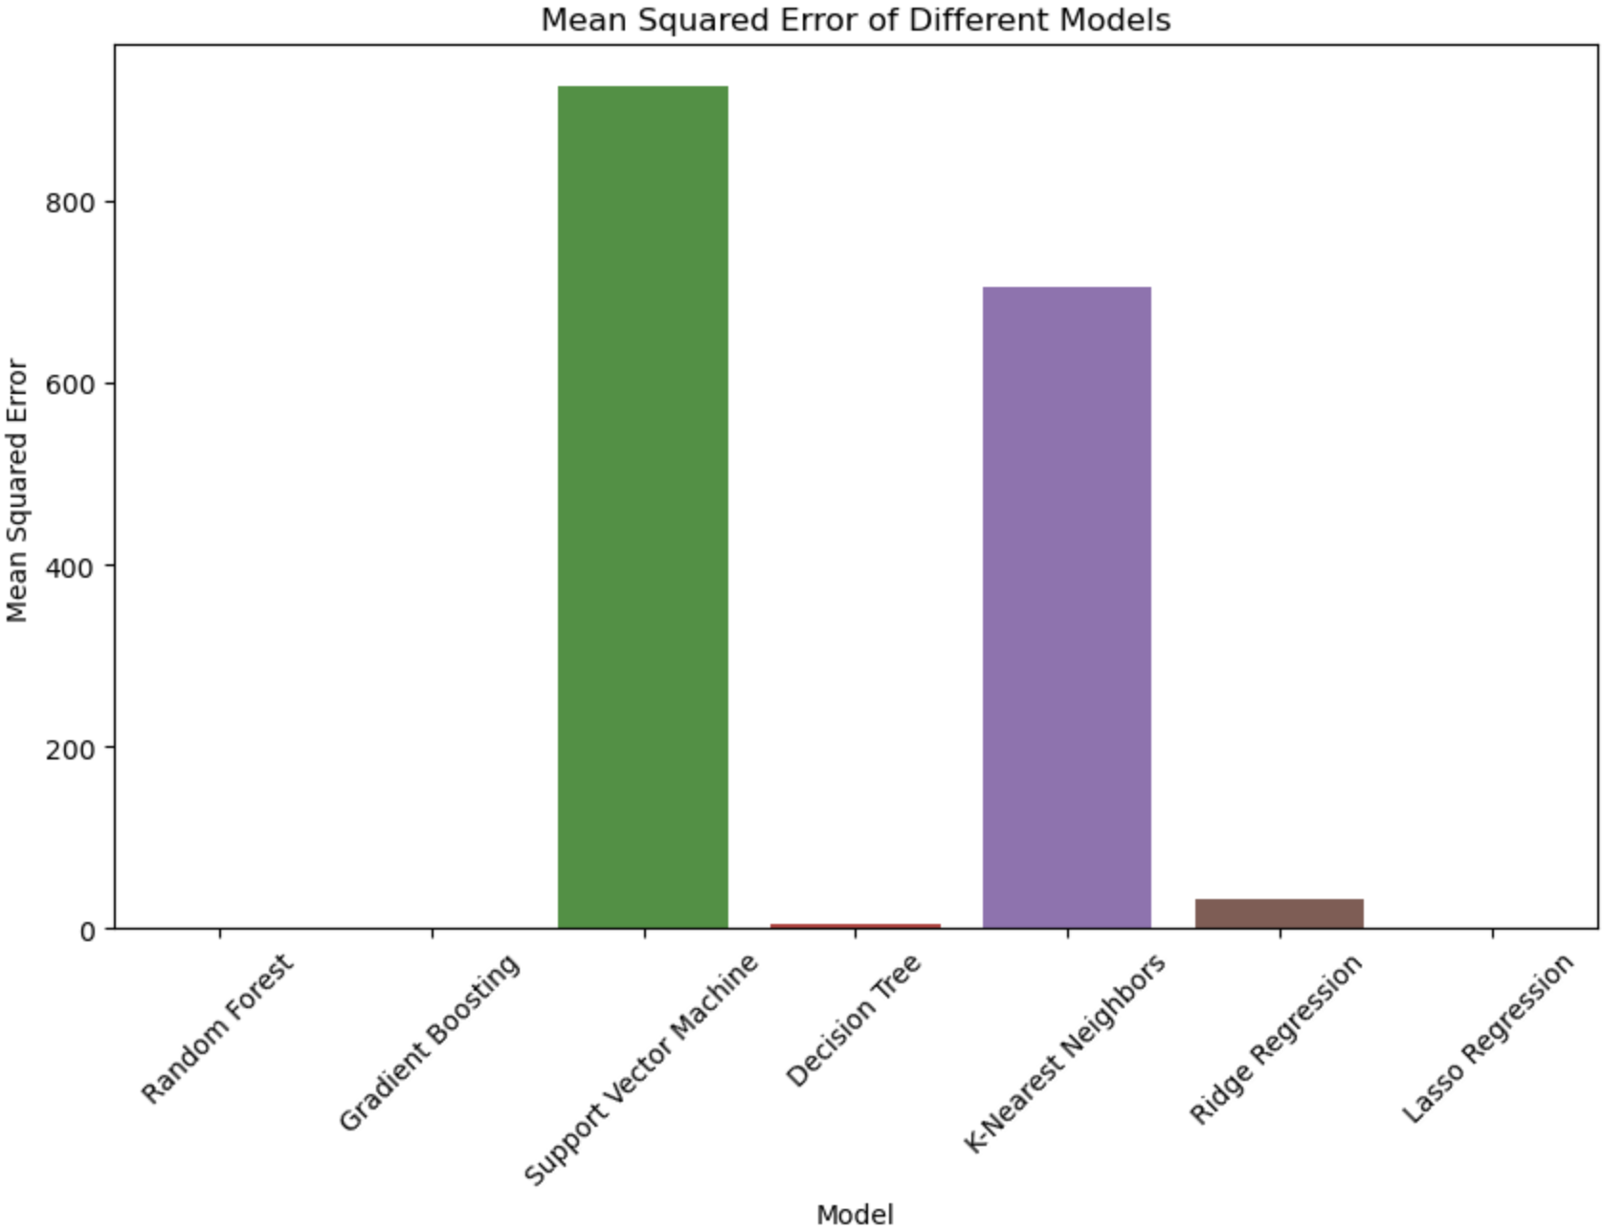
Visualization of results: ML models
Notes:
Dawson

Slide 20
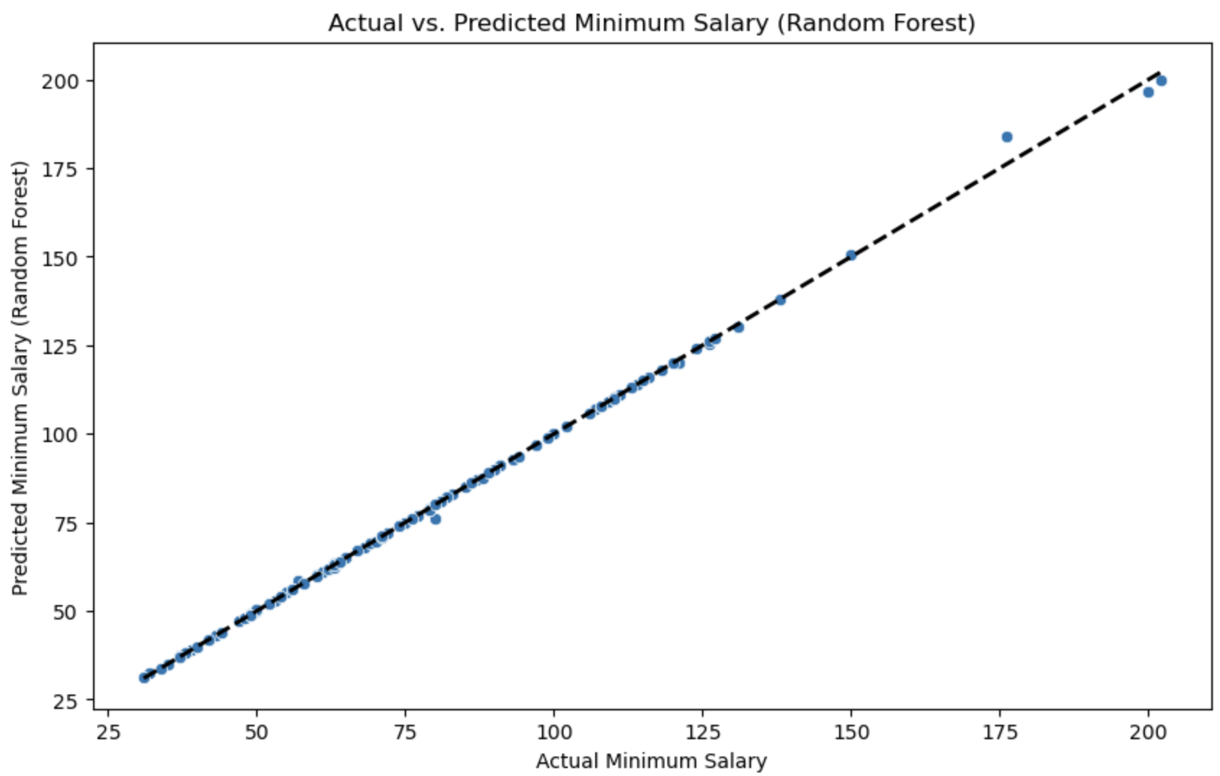

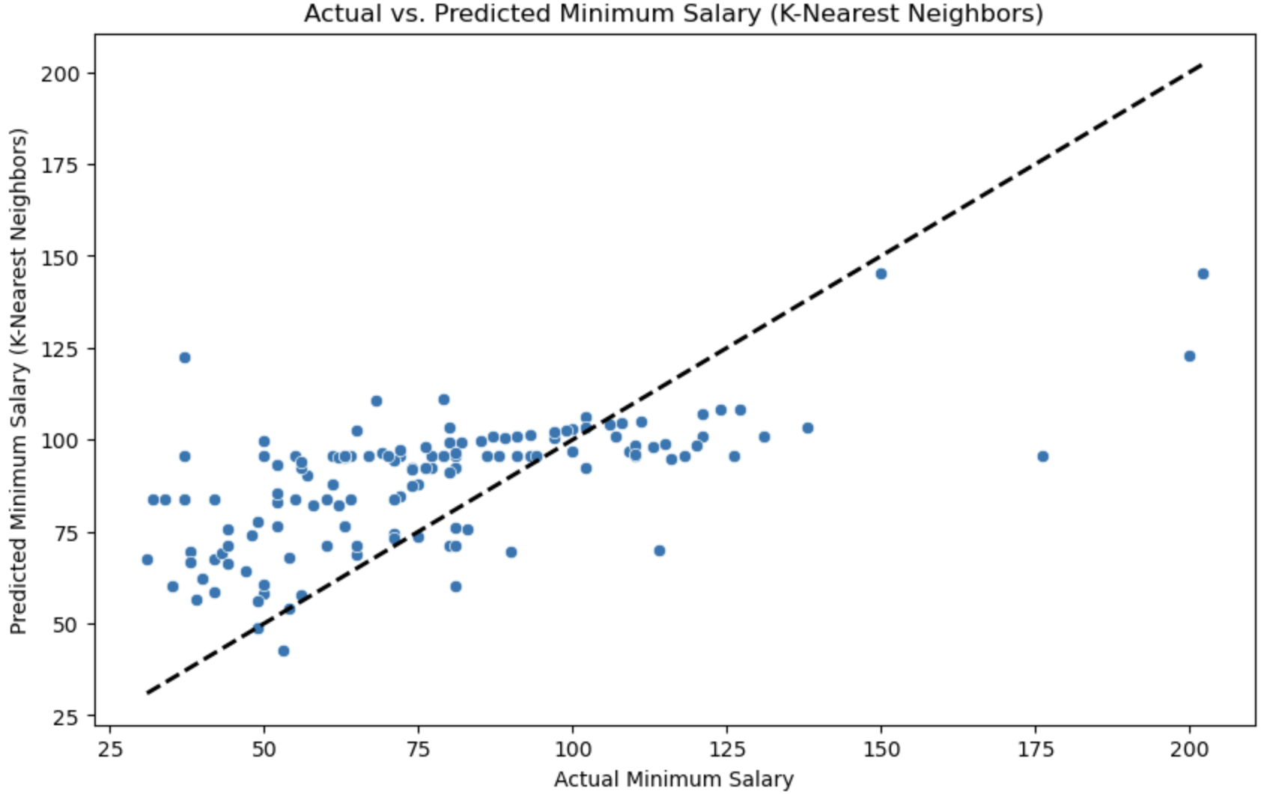
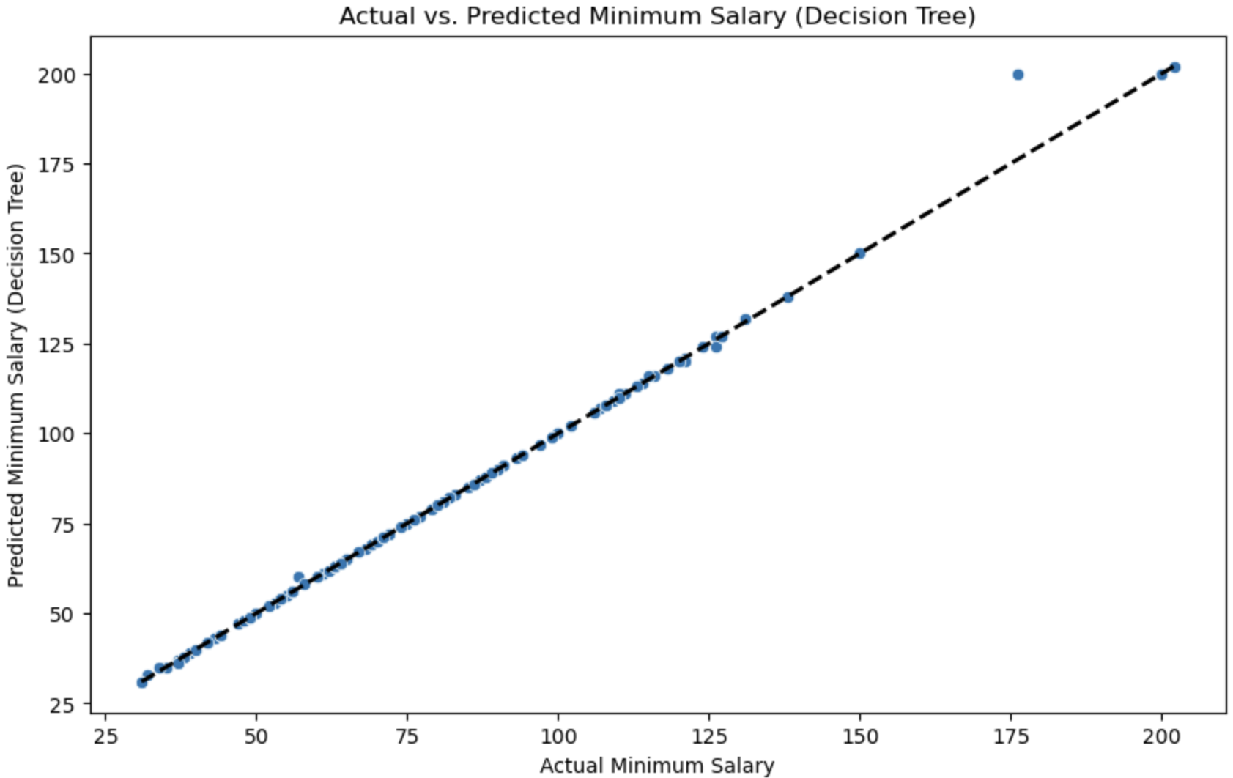
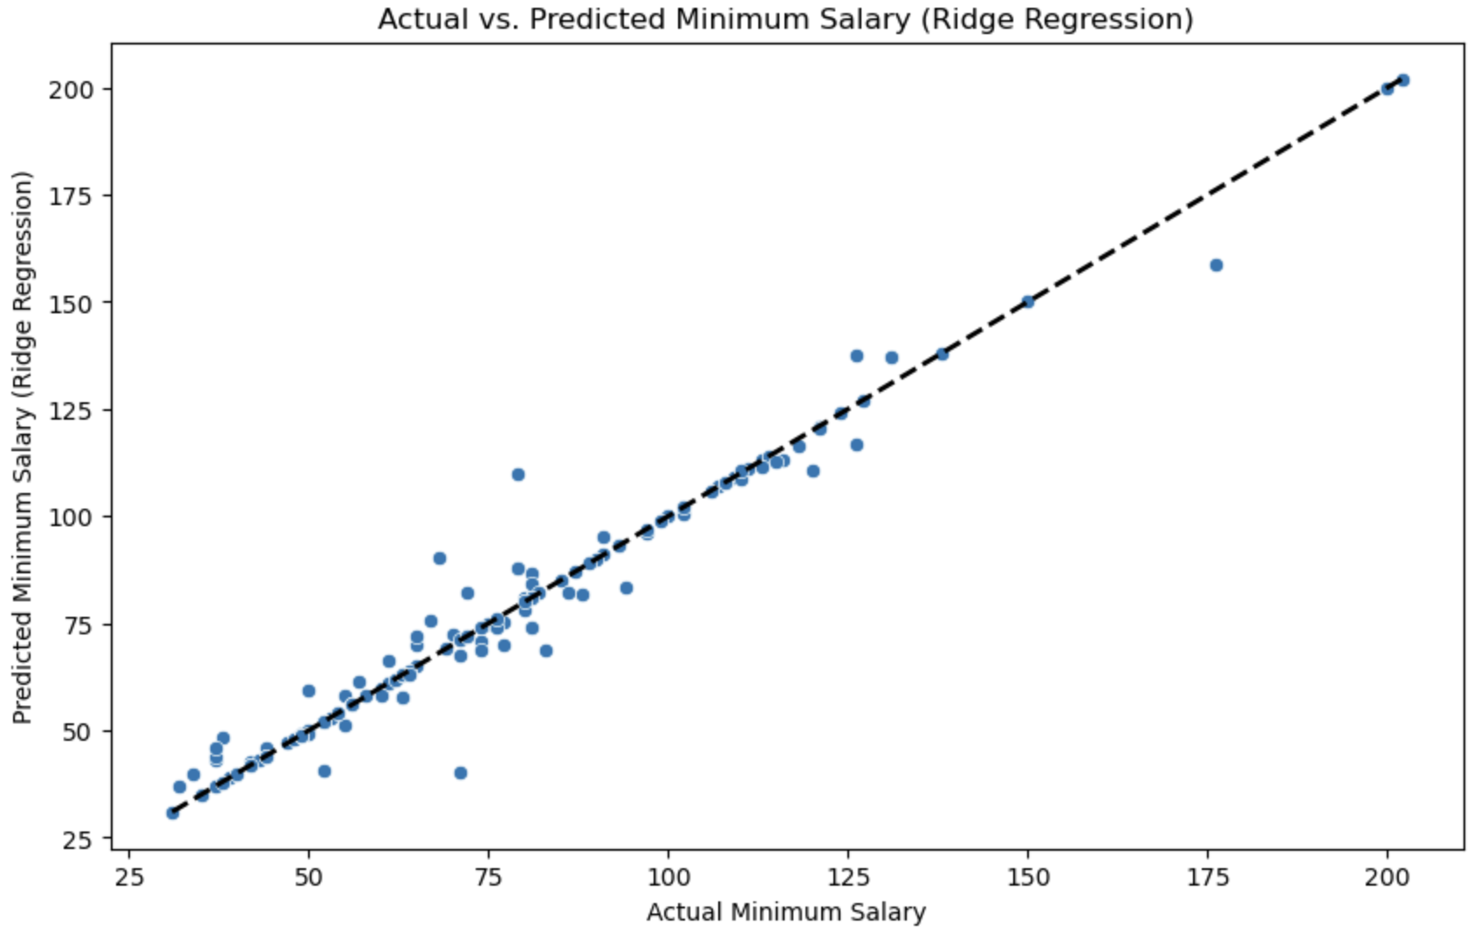
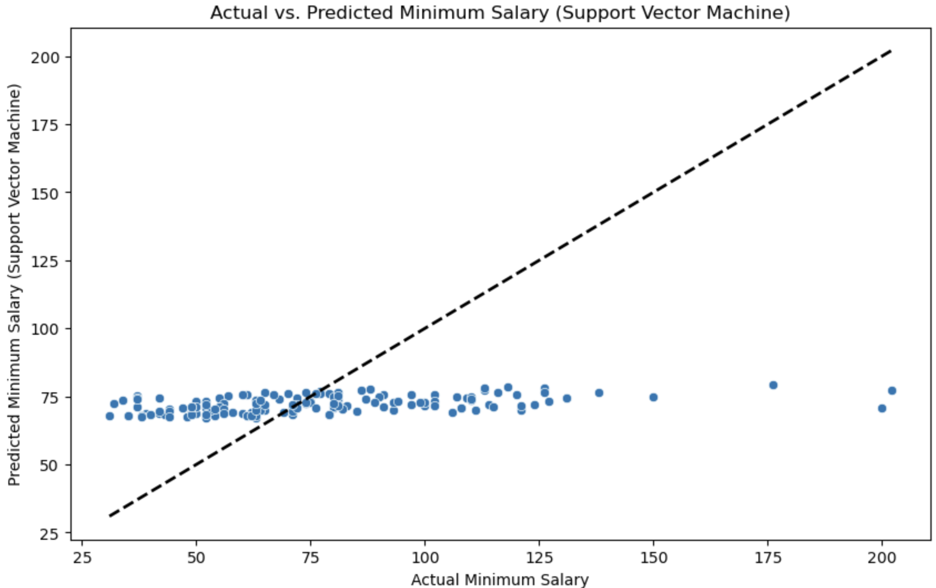
Visualization of results: ML models
Notes:
Dawson

Slide 21
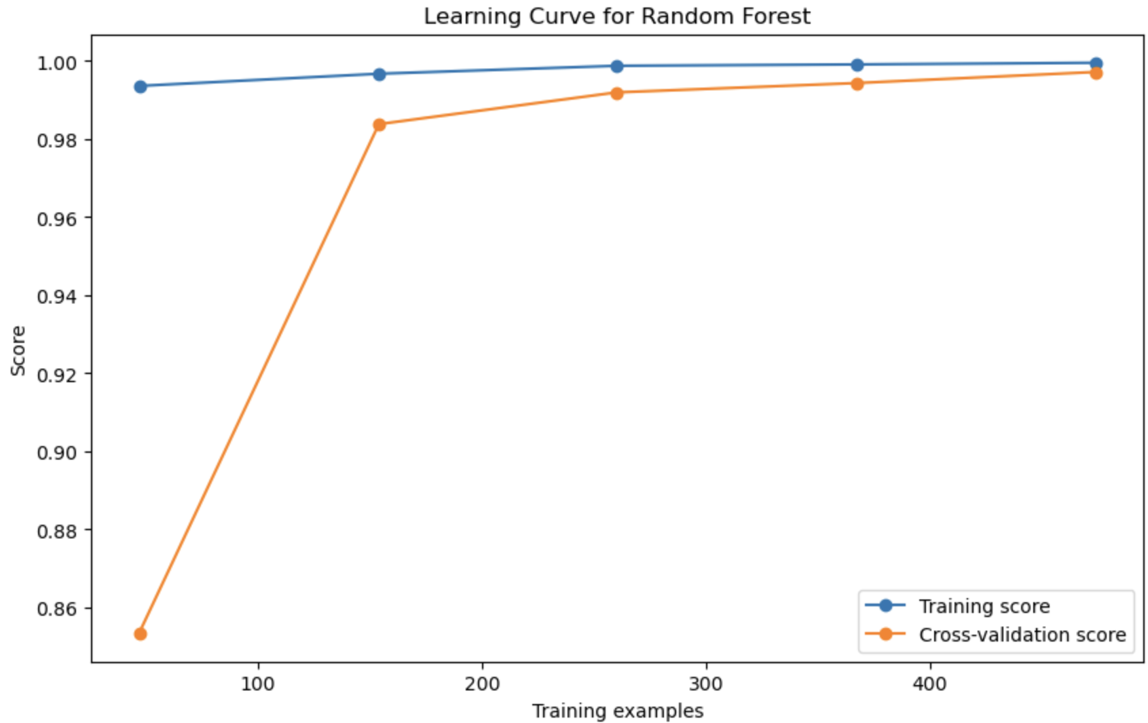
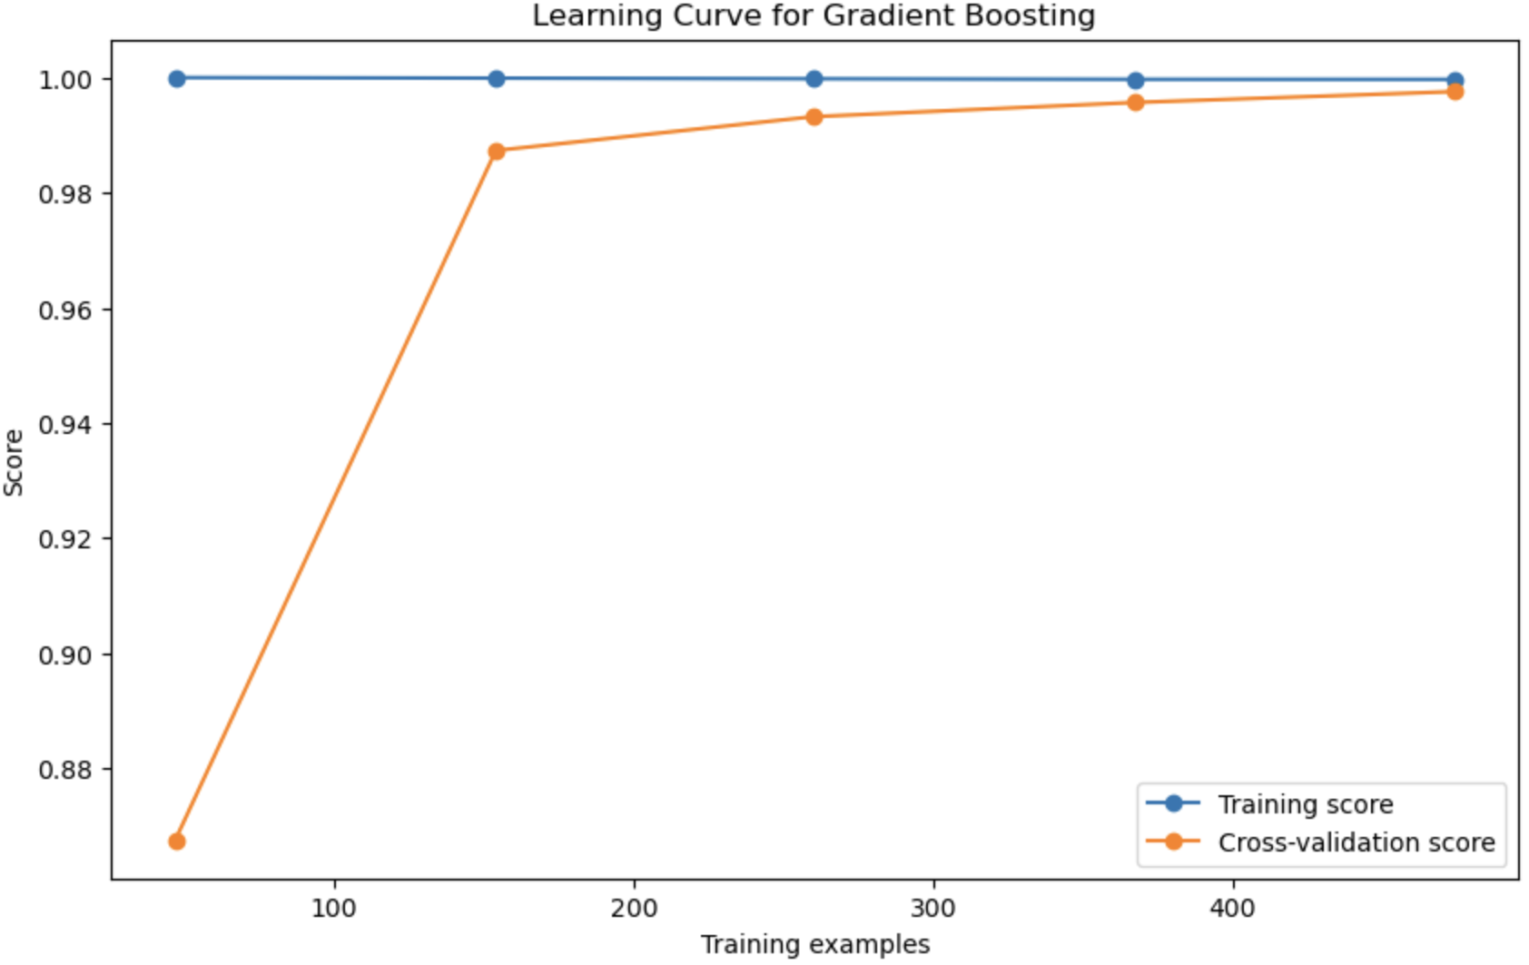
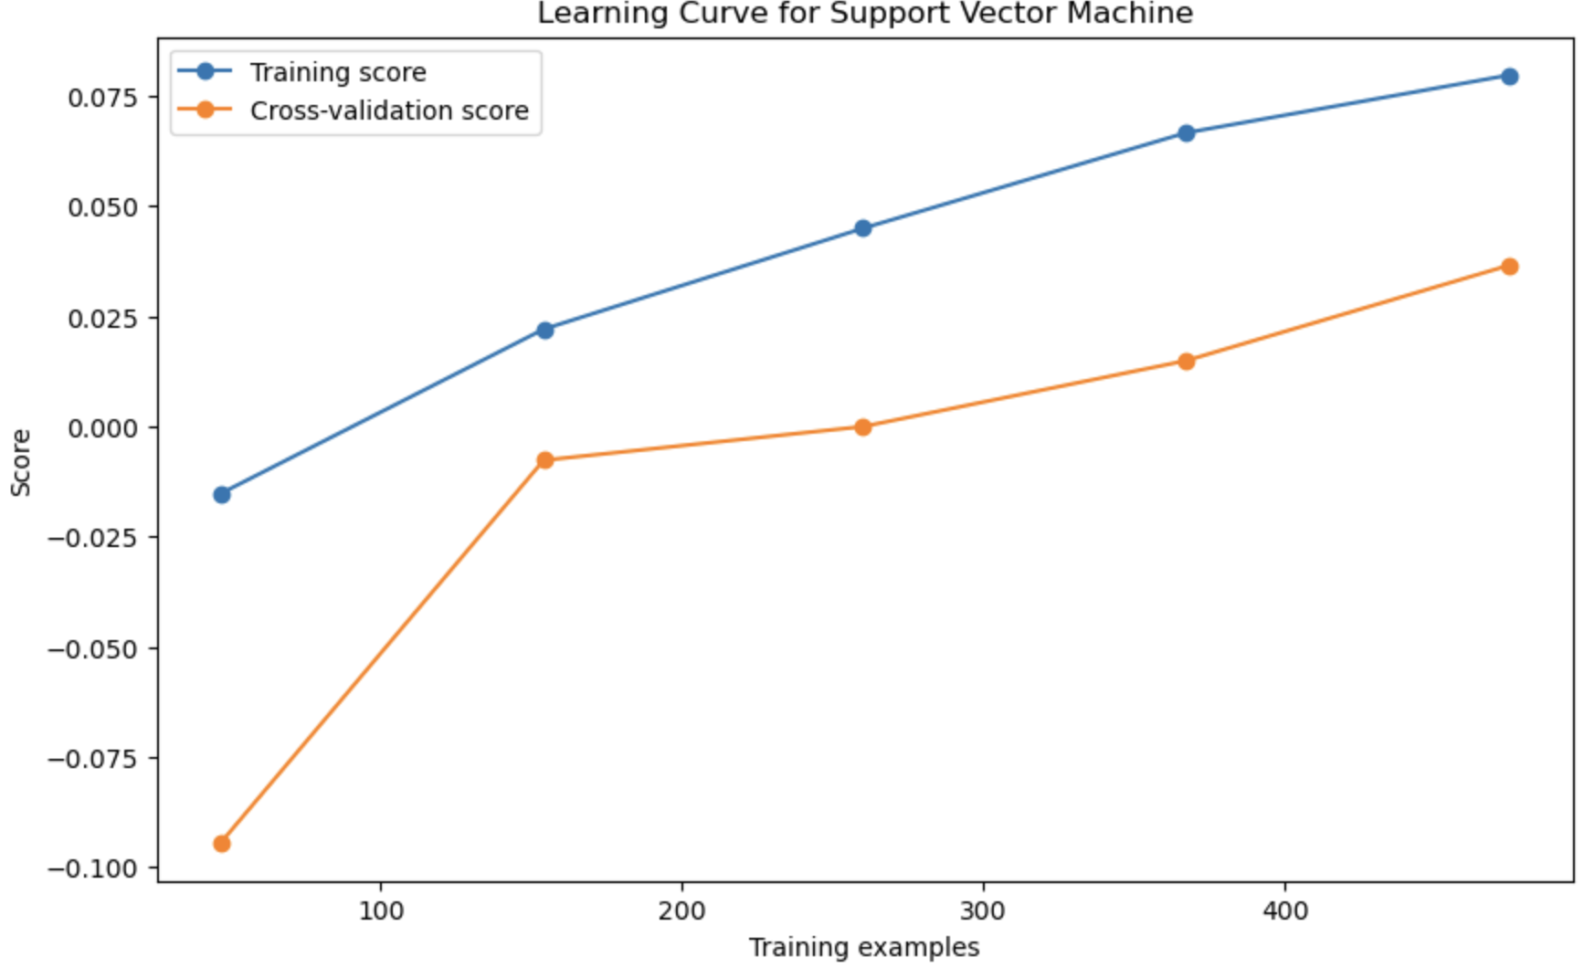
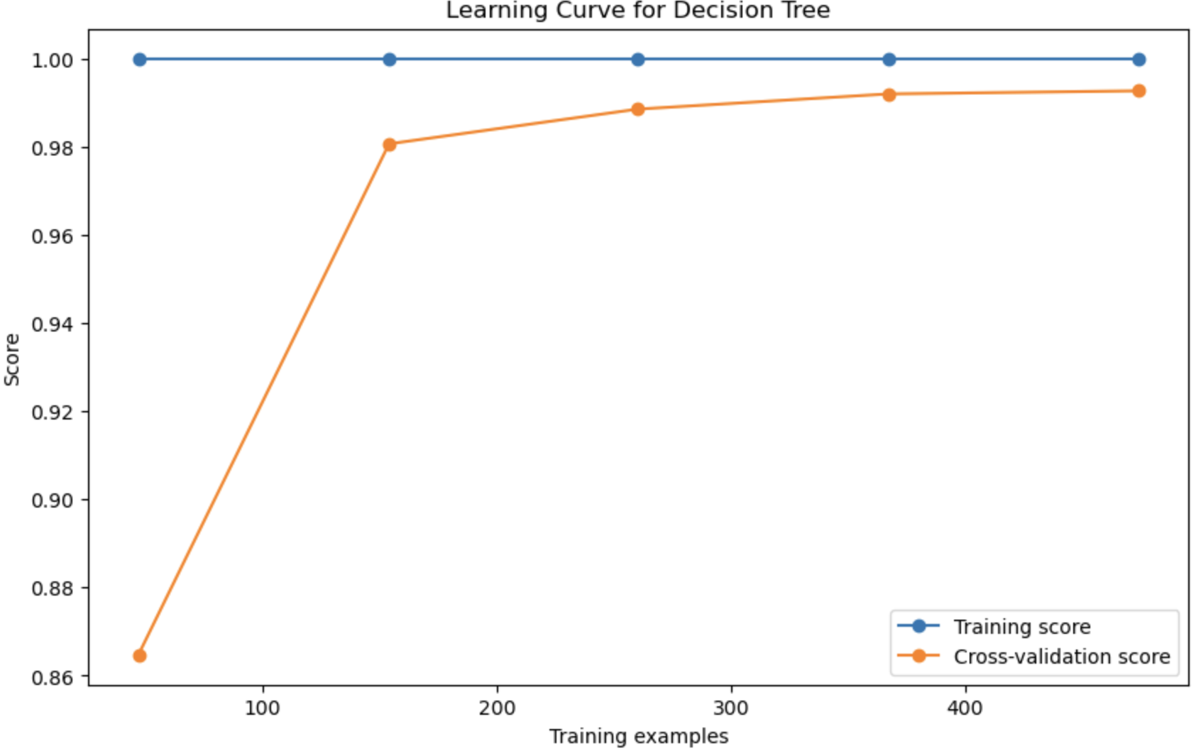
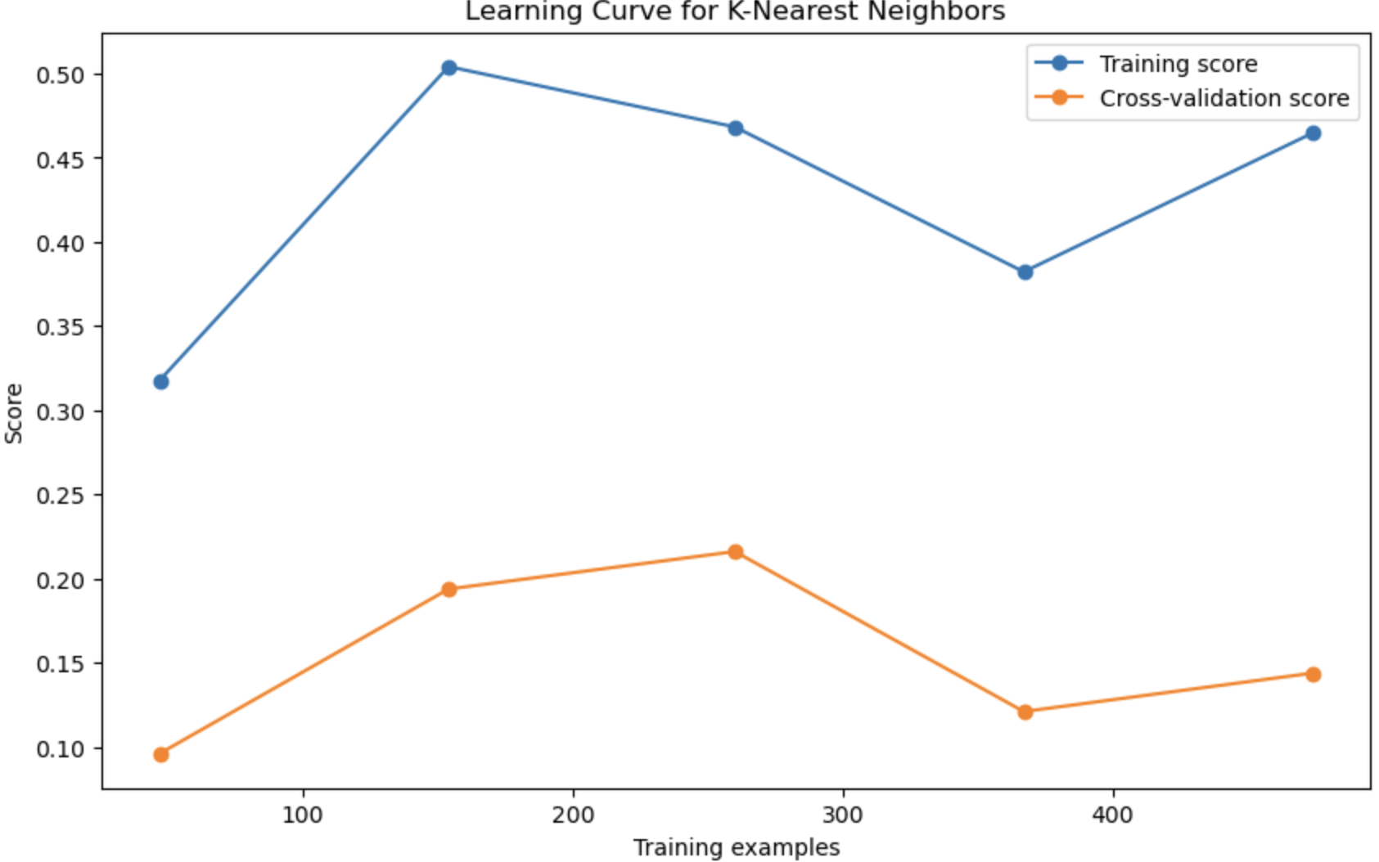
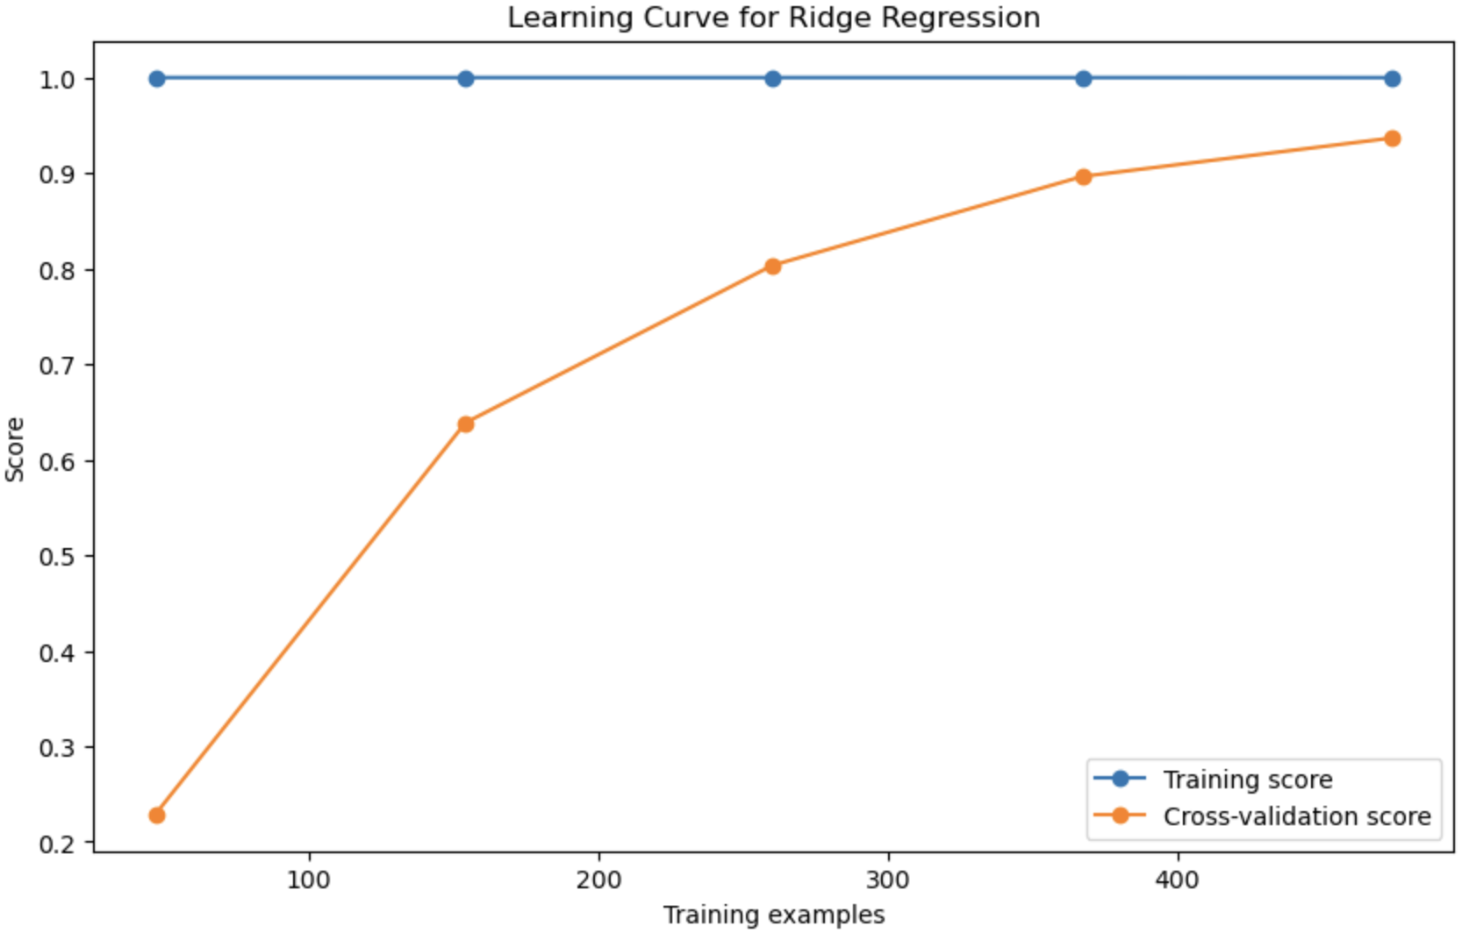
Visualization of results: ML models
Notes:
Dawson

Slide 22
Management of visualization products
Platform: GitHub
Storage: Repository structure for organized storage
Version Control: Git for tracking changes and collaboration
Documentation: README.md for overview and instructions, as well as a detailed .ipynb file
Metadata: File descriptions, commit messages, and issue tracking
Accessibility: Public repository for sharing and collaboration
Maintenance: Regular updates and maintenance for accuracy
Collaboration: Issues and pull requests for feedback and contributions
Security: Access control and permissions for data protection
Notes:
Dawson

Slide 23
Visualization meets the goals
Goal Alignment
Addressing investigation questions regarding salary determinants.
Value Highlight
Clear visualizations aid in understanding complex relationships.
Insight Communication
Presentation enhances communication of findings.
Decision Support
Helps stakeholders make informed decisions based on data.
User Engagement
Encourages engagement and discussion around findings.
Iterative Improvement
Enables iterative refinement based on feedback.
Transparency
Open access fosters transparency and reproducibility.
Knowledge Transfer
Facilitates knowledge transfer and collaboration.
Notes:
Dawson

Slide 24
4.
Data Management Plan
Notes:
Bryan

Slide 25
Data management plan
Creation of logical collections
A logical collection dedicated to salary information will be curated, comprising individual entries representing distinct job postings.
Each entry within this collection will include vital details such as job ID, location, candidate age, skill proficiencies, and associated salary information
Physical data handling
The data is backed up on the source website where the dataset is hosted. If there is any data loss or corruption, the dataset can be restored from backup.
Notes:
Bryan

Slide 26
Data management plan
Interoperability support
This dataset was scraped from Glassdoor job postings and collected into csv files that contain all pertinent information. Using Jupyter notebooks and Kaggle, the site that hosts the dataset, should ensure seamless integration.
Security support
This dataset is entirely public domain, and as such does not need special access authorization
Metadata collection, management, and access
Metadata was exported as a json file using Croissant metadata format for ML datasets
Notes:
Bryan

Slide 27
Data management plan
Persistence
The dataset, originating from 2017, maintains its relevance despite an evolving job market. The dataset is accessible in Kaggle and ensures that it remains a valuable resource for analyzing historical job trends in future studies.
Discovery
Providing clear metadata and categorization will enable users to easily find specific job collections, or filter by attributes such as location or required skills
Notes:
Bryan

Slide 28
Data management plan
Dissemination
Immediate updates or changes to the dataset will be promptly communicated via Discord and Github, ensuring timely awareness among interested parties.
Data ownership
This dataset was scraped from Glassdoor.com by Ramiro Gomez and uploaded to Kaggle.
Notes:
Bryan

Slide 29
Thank You
Notes:
All

